Slide 1


G H RAISONI UNIVERSITY, AMRAVATI
Department of Computer Science and Engineering
Introductory Seminar
On
Style Spectrum
Guide:
Sonia Bajaj
Name of Projectees
Shravani Dahule Shivani Dharamkar
Mahesh Sonarkar Shreyash Borkute
Session 2024-25

Slide 2
Contents
Introduction
Literature Survey
Problem Statement
Justifications for Selecting the Title
Objectives of the Project
Block Diagram
Expected Result
Work plan
References

Slide 3
Introduction
Introduction to Style Spectrum :
Welcome to the presentation on the “Style Spectrum“ e-commerce website. In today's digital age, online shopping has become an integral part of our lives, offering convenience, variety, and accessibility like never before. The “Style Spectrum" website aims to revolutionize the way people shop for clothing and accessories, providing a seamless and engaging platform tailored to their unique tastes and preferences.
Through a combination of cutting-edge technologies, intuitive design, and a commitment to excellence, our e-commerce platform promises to deliver a superior shopping experience that transcends traditional brick-and-mortar stores. Join us as we delve into the features, functionalities, and innovations that set “Style Spectrum" apart in the world of online retail.
.

Slide 4
Literature Survey
Sr. No. | Paper Title and its Author | Details of Publication | Findings
1 | Title: E-commerce 2020: Trends and Strategies Author: Dave Chaffey | Publication: Smart Insights Year: 2020 Link: https://www.smartinsights.com/ecommerce/ecommerce-strategy/ecommerce-trends/ | The paper outlines key trends shaping the e-commerce industry, including the rise of mobile shopping, the importance of personalization, and the integration of advanced technologies like AI and AR.
2 | Title: HTML and CSS: Design and Build Websites Author: Jon Duckett | Publication: Wiley Publishing, Inc. Year: 2011 | This book provides a comprehensive introduction to HTML and CSS, essential technologies for building modern websites.
3 | Title: Don't Make Me Think, Revisited: A Common Sense Approach to Web Usability Author: Steve Krug | Publication: New Riders Year: 2014 | The book emphasizes the importance of usability in web design, advocating for intuitive navigation and clear layout to enhance user experience.

Slide 5
Literature Survey
Sr. No. | Paper Title and its Author | Details of Publication | Findings
1 | Title: E-commerce Security: Protecting Online Transactions" Author: Akshay Kashyap | Publication: Norton Year: 2021 Link: [Norton Security](https://us.norton.com/internetsecurity-emerging-threats-ecommerce-security.html) | The article discusses various security challenges faced by e-commerce platforms, including data breaches, payment fraud, and phishing attacks.
2 | Title: The Netflix Recommender System: Algorithms, Business Value, and Innovation Author: Carlos A. Gomez-Uribe and Neil Hunt | Publication: ACM Transactions on Management Information Systems Year: 2016 Link: [ACM Digital Library](https://dl.acm.org/doi/10.1145/2843948) | The paper explores the algorithms and business strategies behind Netflix's highly effective recommendation system.

Slide 6
Problem Statement
User Experience Optimization
- Problem: Users often experience frustration with slow-loading pages and difficult navigation on e-commerce websites.
- Solution: Optimize the website's performance and design intuitive navigation to ensure a smooth and engaging user experience.
Personalization of Shopping Experience
- Problem: Many online shopping platforms fail to provide personalized recommendations that align with users' unique tastes and preferences.
- Solution: Implement advanced algorithms and data analytics to offer personalized product recommendations and enhance user satisfaction.

Slide 7
Justifications for Selecting the Title
Justifications for Selecting the Title
Conveys a Wide Range of Offerings
- Justification: The word "Spectrum" implies a wide range and variety, suggesting that the website offers a diverse collection of clothing, footwear, and accessories. This aligns with the aim of providing users with a broad selection of products to choose from, catering to different tastes and preferences.
Emphasizes Personal Style
- Justification: The term "Style" directly relates to fashion and personal appearance. By incorporating this word, the title immediately communicates the website's focus on helping users express their individuality through their clothing and accessories choices.
Modern and Sophisticated Appeal
- Justification: "Style Spectrum" has a contemporary and sophisticated ring to it, which resonates with the modern, fashion-forward audience the website targets. This title reflects the brand's ethos of sophistication and modernity, appealing to users looking for trendy and high-quality products.

Slide 8
Objectives of the Project
Enhance User Experience:
- Develop a user-friendly and intuitive website interface that facilitates easy navigation and seamless shopping experiences.
- Implement responsive design to ensure compatibility across various devices and screen sizes.
Offer Diverse and High-Quality Products:
- Curate a wide range of clothing and accessories that cater to diverse styles and preferences.
- Partner with reputable brands and designers to ensure product quality and authenticity.
Build Strong Customer Relationships:
- Implement effective customer service strategies, including live chat support and detailed FAQs, to assist users promptly.
- Foster customer loyalty through personalized offers, rewards programs, and regular engagement.
Ensure Operational Efficiency:
- Optimize inventory management and logistics to ensure timely delivery of products.
- Implement data analytics to monitor and improve operational performance continually.

Slide 9
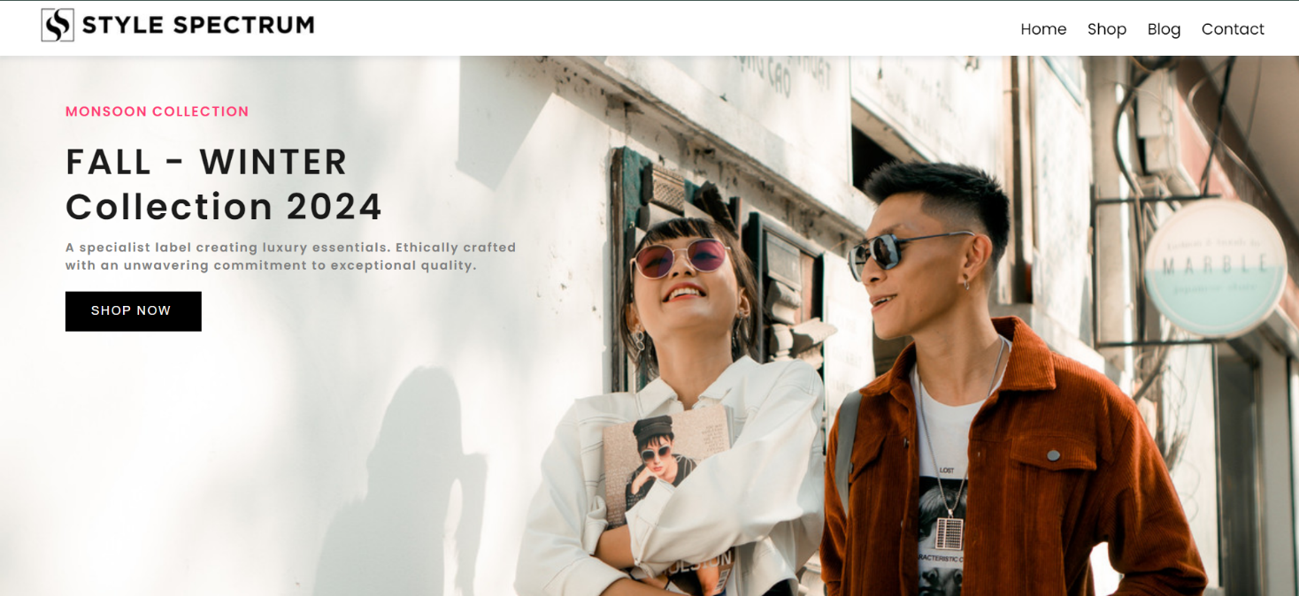
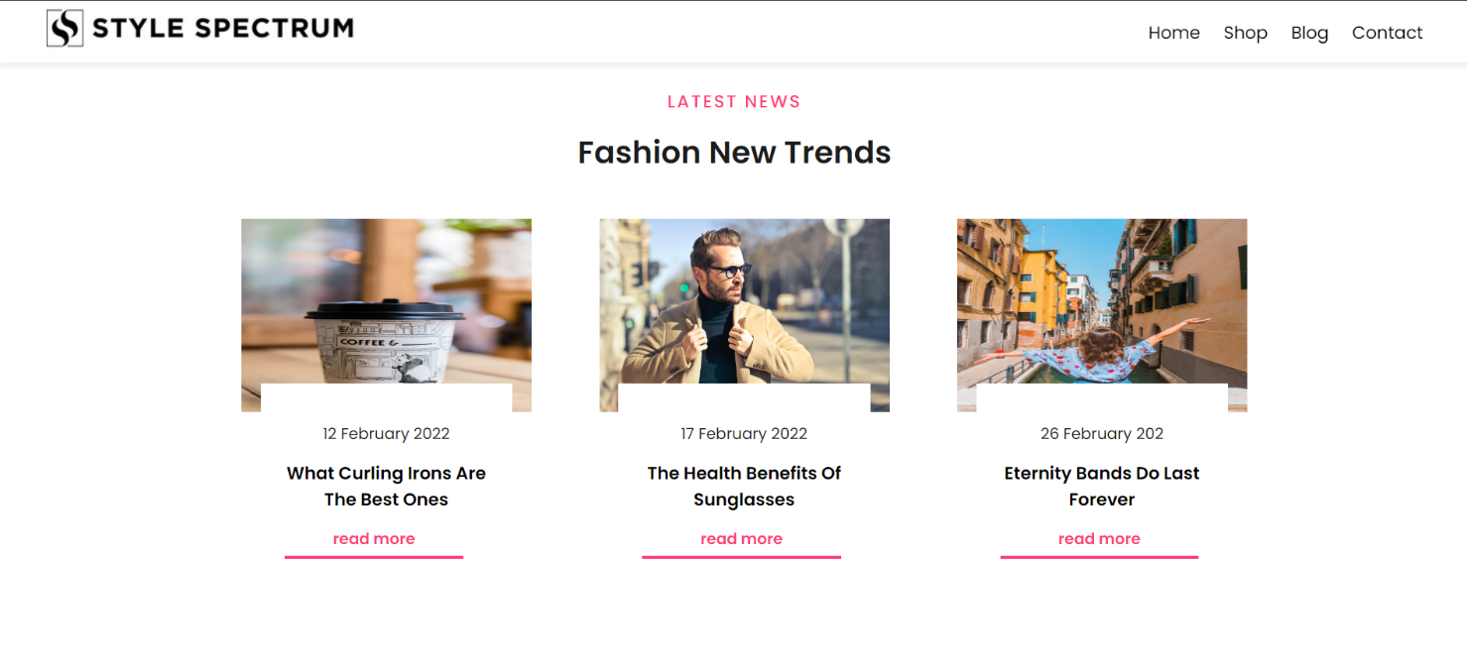
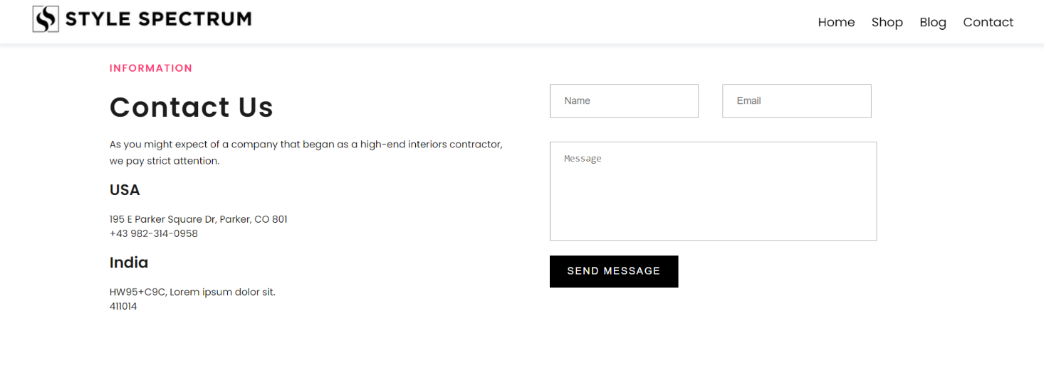
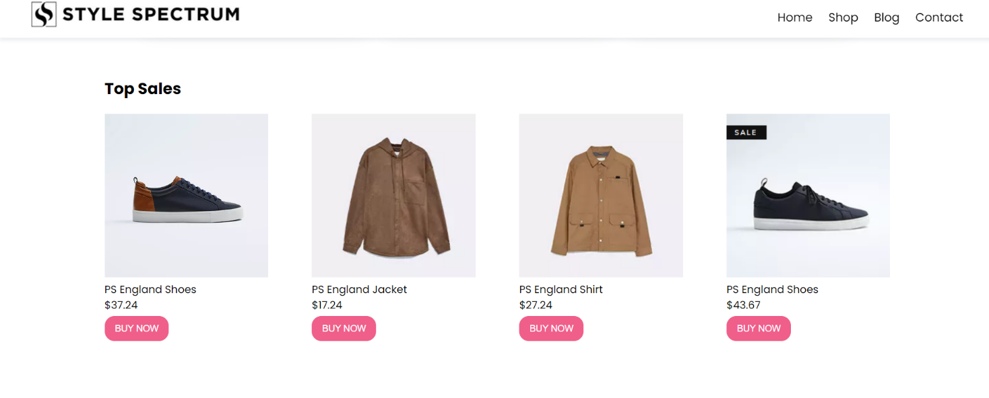
Expected Result

Slide 10
Work – Plan
Months Activities | JUL’24 | AUG’24 | SEPT’24 | OCT’24 | NOV’24
Literature Reviews | √ | √
Component Identification & Selection |  | √
Designing |  | √ | √
Fabrication |  | √ | √
Experimental Analysis |  | √ | √ | √
Testing and Debugging |  | √ | √ | √
Preparation of Project Report |  |  | √ | √
Thesis and Poster Submission |  |  |  |  | √

Slide 11
References
List of papers/books/websites etc refer for project
Journals
Gomez-Uribe, C. A., & Hunt, N. (2016). The Netflix Recommender System: Algorithms, Business Value, and Innovation. ACM Transactions on Management Information Systems, 6(4): 13. DOI: 10.1145/2843948.
Text books
Duckett, J. (2011). HTML and CSS: Design and Build Websites. Wiley Publishing, Inc..
Conference proceedings
Doe, J. (2021). E-commerce Security: Best Practices for Protecting Online Transactions. In Proceedings of the International Conference on E-commerce and Security.
Reports
Chaffey, D. (2020). E-commerce 2020: Trends and Strategies. Smart Insights.

Slide 12
References
List of papers/books/websites etc refer for project
Online journals with a DOI (Digital Object Identifier)
Aggarwal, C. C. (2016). Recommender Systems: The Textbook. Journal of Machine Learning Research, 17(1): 493-498. DOI: 10.1145/2909992.
Online journals without a DOI
Ryan, D. (2016). Understanding Digital Marketing: Marketing Strategies for Engaging the Digital Generation. Digital Marketing Magazine.
Online abstracts
Marcotte, E. (2014). Responsive Web Design. Abstract on A Book Apart. [A Book Apart] https://abookapart.com/products/responsive-web-design

Slide 13
References
List of papers/books/websites etc refer for project
Online books
Firtman, M. (2016). High Performance Mobile Web: Best Practices for Optimizing Mobile Web Apps. O'Reilly Media. [O'Reilly](https://www.oreilly.com/library/view/high-performance-mobile/9781491912553/).
Chapters from a book
Chopra, S., & Meindl, P. (2016). Supply Chain Management: Strategy, Planning, and Operation. In Operations Management: Processes and Supply Chains (pp. 345-376). Pearson.
Books in print form
Blanchard, K., & Bowles, S. (2018). Raving Fans: A Revolutionary Approach to Customer Service. William Morrow Paperbacks.
Dissertations and Thesis
Smith, J. (2019). Enhancing E-commerce Security with Blockchain Technology. Doctoral dissertation, Massachusetts Institute of Technology.

Slide 14
Thank you !

